Slide 1
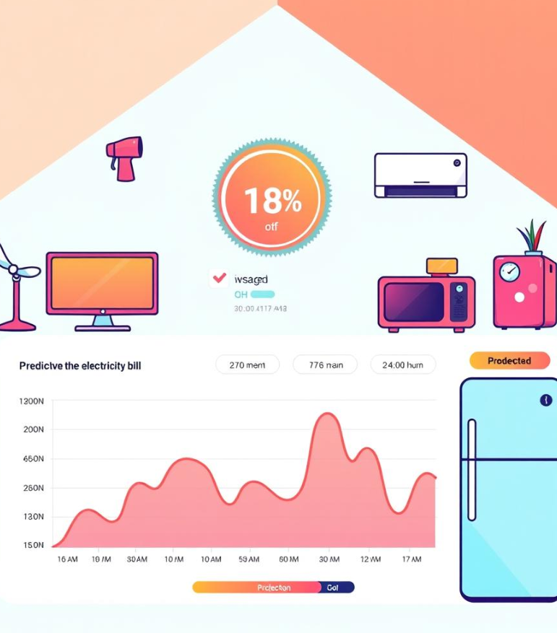
Electricity Bill Prediction
111723720034 R.Sujith

Slide 2
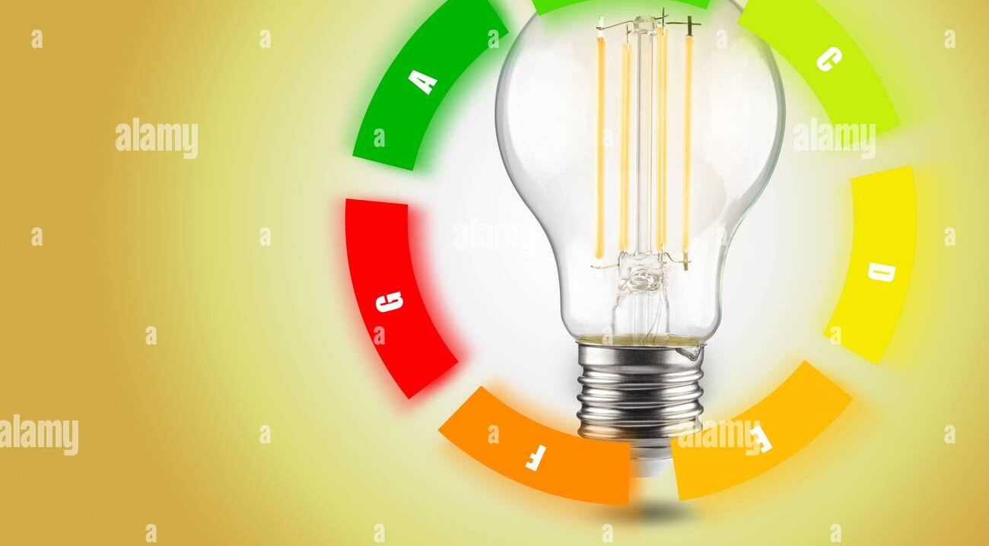

Abstract
The key objective is to create an automated system that predicts electricity bills with high accuracy, enabling consumers to better manage their energy usage and reduce costs. Moreover, energy providers can optimize billing processes and predict future load demand.This study presents a framework for electricity bill prediction using machine learning techniques, demonstrating significant improvements in prediction accuracy and efficiency compared to traditional approaches.

Slide 3
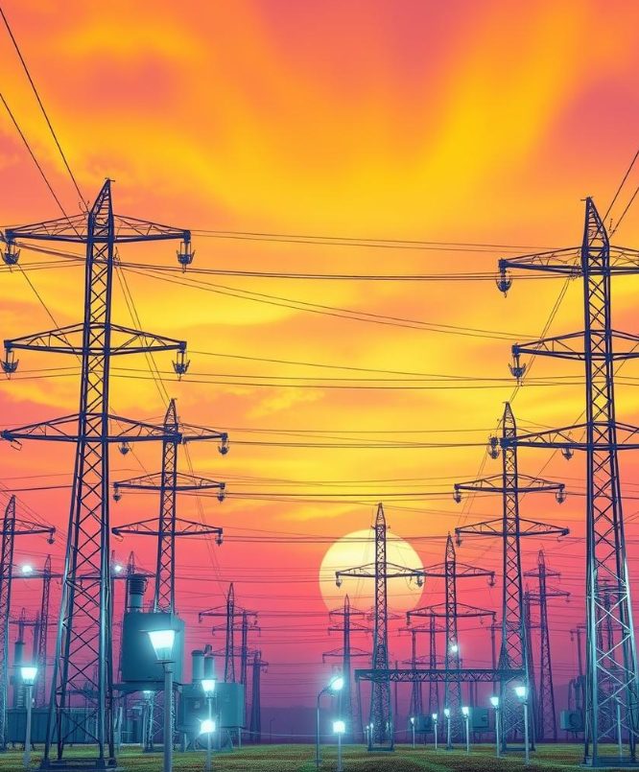
Introduction
This mini project on "Electricity Bill Prediction" aims to create a machine learning model that can accurately predict the electricity bill for a given household or establishment.
The dataset is taken from Kaggle website which contains data on working hours of various electric devices at different periods .

Slide 4
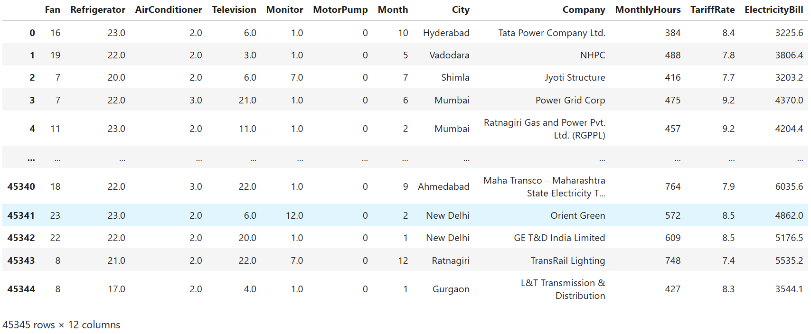
About Dataset

Slide 5
Features
Fan :It represents the number of working hours of fan in a day
Refrigerator: It represents the number of working hours of a refrigerator
AirConditioner: It represents the number of working hours of AC in a day
Television: It represents the number of working hours of TV in a day
Monitor: It represents the number of working hours of monitor in a day
MotorPump: It represents the number of working hours of pump in a day
1
2
3
4
5
6

Slide 6
Features
Month: It represents a month from 1-12
City: It represents the area of consumption in various cities
Company: It represents the company providing electricity to different location
Monthly Hours: It represents total Hours of working in an month
Electricity Bill: It represents the total Bill amount based on thwe working hours
TarrifRate: It represents the availability and demand of consumption
7
8
9
10
11
12

Slide 7
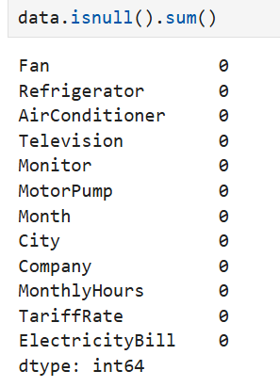
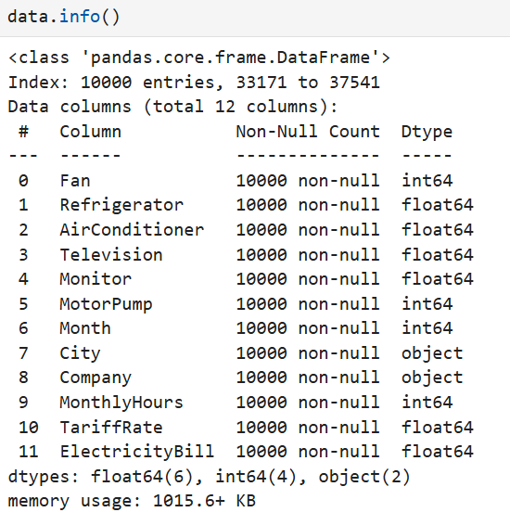
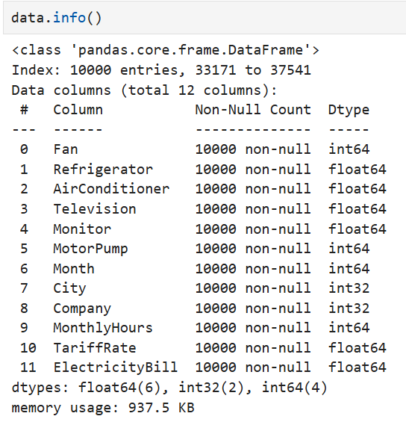
Preprocessing
Null Values Feature conversion

Slide 8
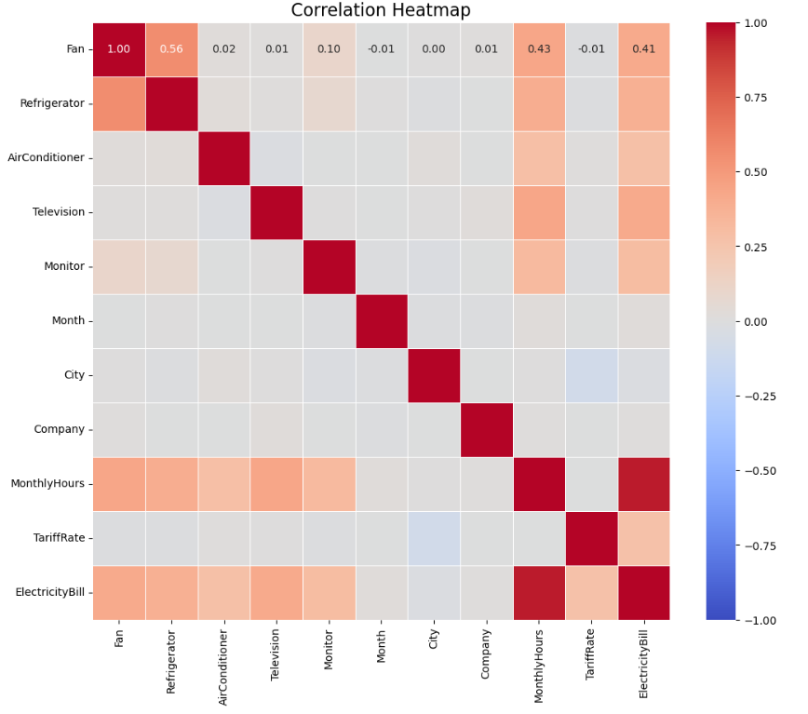
Correlation
h
Blue hues: Indicate negative correlations.
Gray areas: Suggest negligible or no correlation.
Red hues: Indicate positive correlations.

Slide 9
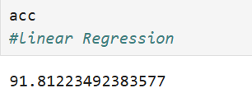
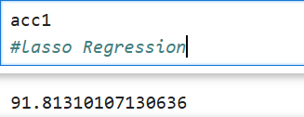
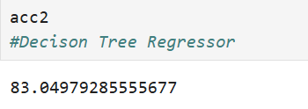
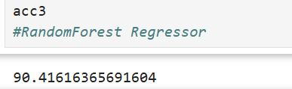
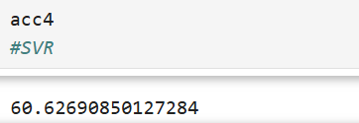
Algorithms used

Slide 10
Libraries used
NumPy: A library for numerical computing in Python, providing support for large, multi-dimensional arrays.
Pandas: A data manipulation and analysis library that provides data structures like DataFrames.
Matplotlib: A plotting library for creating static, animated, and interactive visualizations in Python.
Pickle: A module for serializing and deserializing Python objects, allowing you to save Python objects to a file and load them back later.
Tkinter: A built-in Python library for creating graphical user interfaces (GUIs)

Slide 11
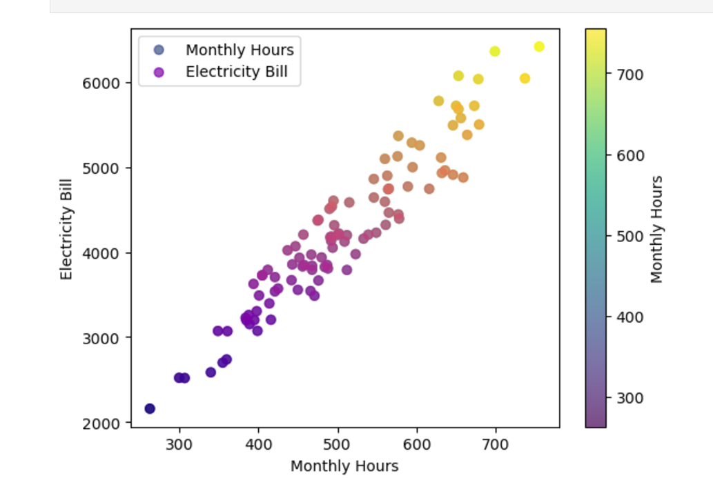
EDA(Exploratory Data Analysis)
As the monthly working hours increases, the electricity bill would rise in a somewhat linear manner, depending on the efficiency of electricity usage.

Slide 12
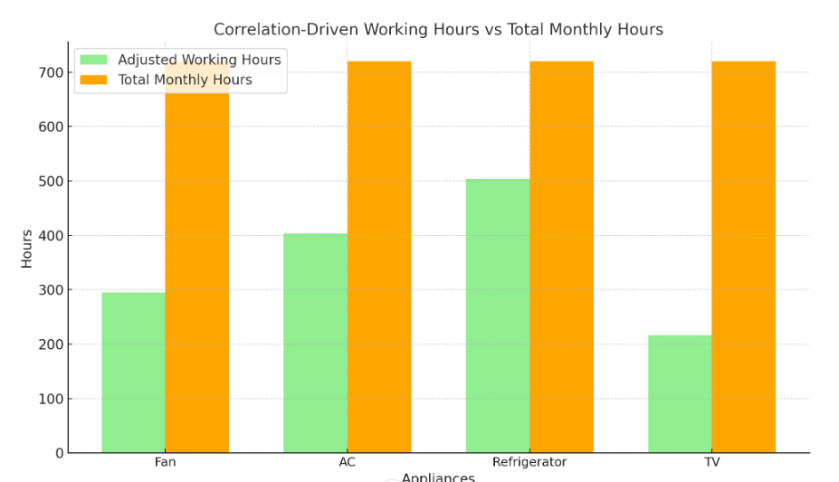
EDA

Slide 13
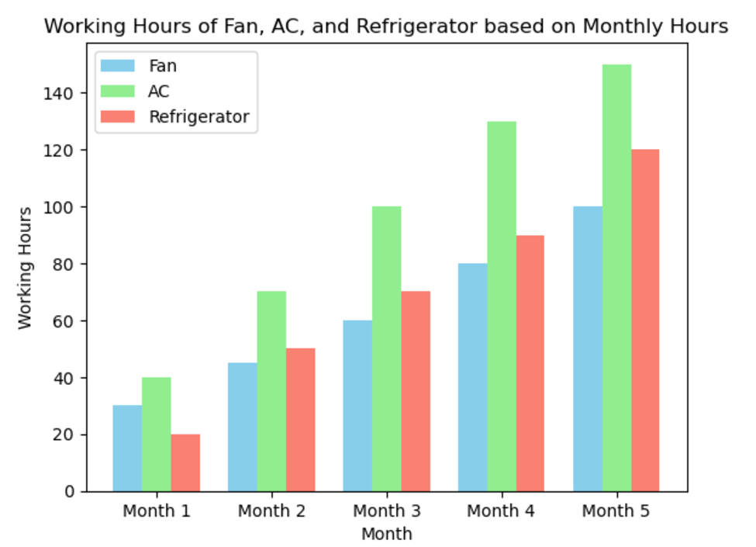
EDA
This graph shows the relationship between the working hours of the fan, AC, and refrigerator across different months.

Slide 14
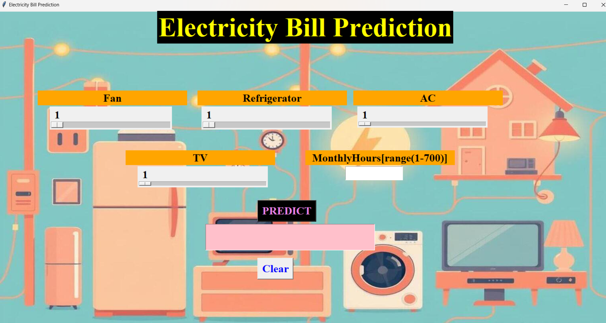
Deployment

Slide 15
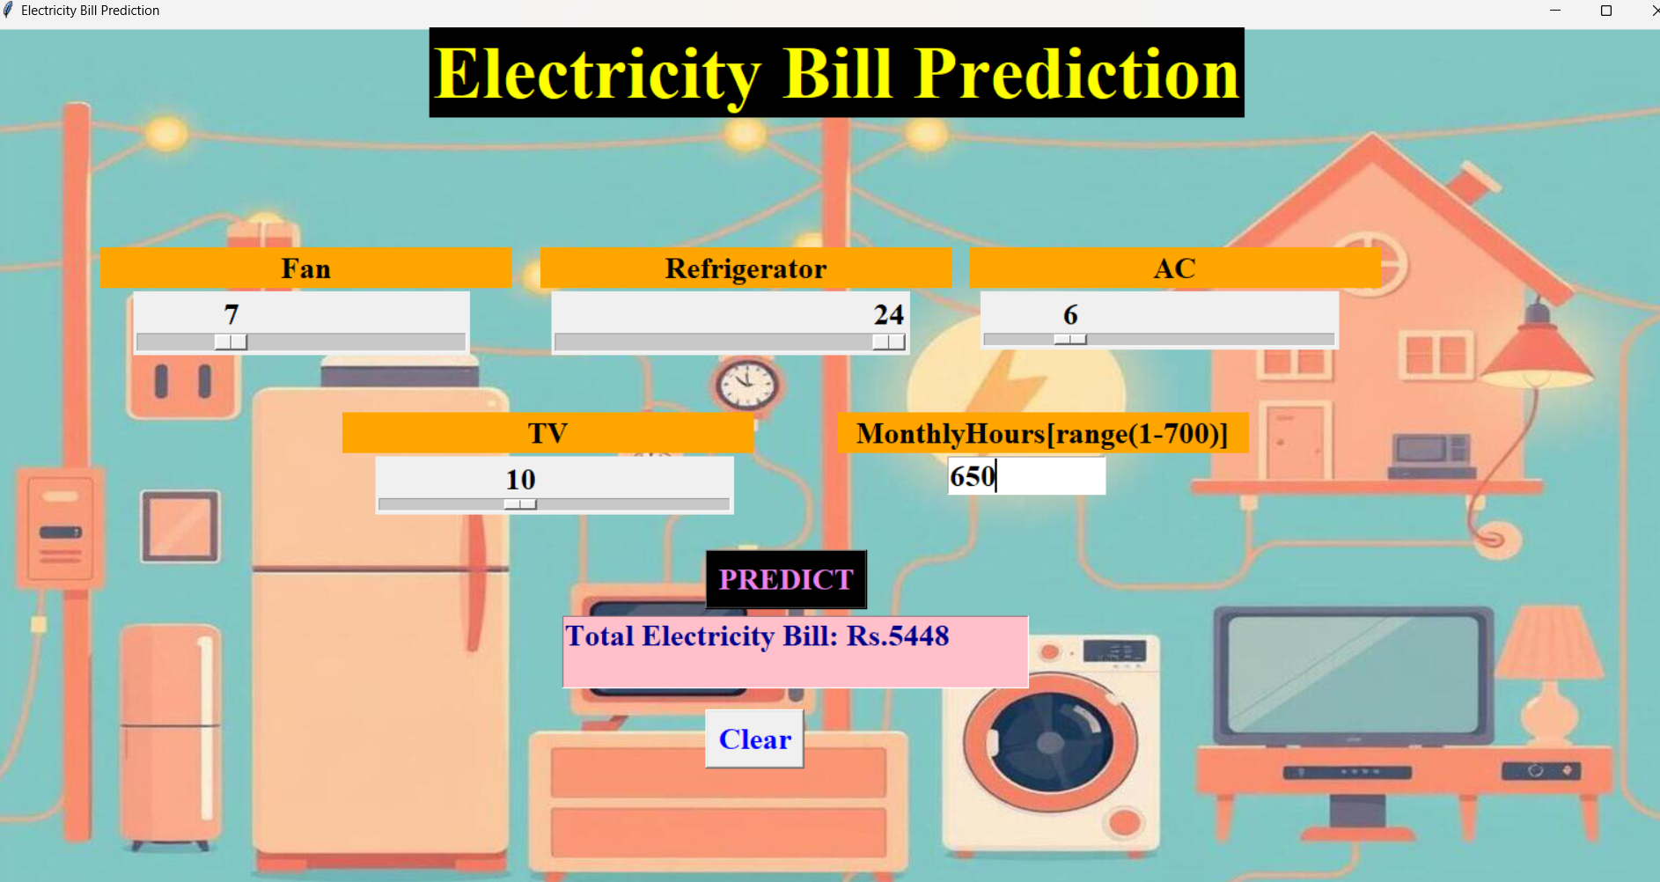
Result

Slide 16
Conclusion
Feature Impact: The model showed that the number of working hours for high-energy appliances like air conditioners and refrigerators had a significant impact on the total electricity bill, while appliances with lower power consumption like fans had a comparatively smaller influence.
The model can be employed in households and businesses to estimate energy costs based on appliance usage, enabling better energy management practices and helping users monitor their electricity consumption more effectively.

Slide 17
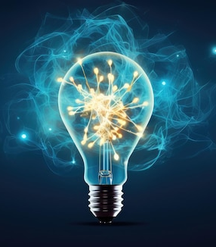
Future Scope
Enhancement of Prediction Accuracy
Feature Expansion: Add more appliances, consider appliance ratings (watts), usage patterns, and seasonal effects. Incorporating External Factors: Include factors like electricity tariffs, peak-hour pricing, and renewable energy contributions.
Advanced Algorithms: Experiment with more complex models such as Gradient Boosting (e.g., XGBoost), Neural Networks, or AutoML tools to enhance prediction accuracy.

Slide 18
THANK YOU

